Slide 1

Amazon Reviews Sentiment Analysis, Segmentation, Classification & Prediction leveraging Multi Class Multi Output Classification
By
G Yogesh Singh
H.T.No: 20567T7606
KUCET (CSE Department)

Slide 2
E-Commerce
Introduction
Importance of Reviews
Reviews Classification

Slide 3
Binary Classification
Each text is classified such that it is represented by only one of two labels
Spam Filter (Ham, Spam)
Reviews
Classification
Multi-Class Classification
Each text is classified such that it is represented by only one labels and has more than two labels
Sentiment Analysis (Positive, Negative, Neutral)
Multi-Label Classification
Each text can have either a single label or more than one label
Fabric quality, Express Delivery, Order Size

Slide 4
Vanaja et al. [16] performed aspect-level sentiment analysis on Amazon customer review data. They analyzed whether the reviews were positive, negative, or neutral. They stated that they found 0.9023 accuracy using naive Bayes in their comparative analysis.
Jabbar et al. [17] presented a real-time sentiment analysis of the product reviews of e-commerce applications. They used SVM to design a model for sentiment analysis of collected review data from Amazon. They labeled reviews as positive or negative. They obtained an F1 score of 0.9354 for the reviews’ sentiment analysis using SVM.
Tripathi et al. [19] examined the textual content of reviews on e-commerce websites with different helpfulness votes to further classify a new review by collecting reviews from e-commerce websites. They stated that the best accuracy was 0.945, obtained with a random forest classifier.
Related Work

Slide 5
Review Intention
(Negative text but rating 5 star)
Problem Statement
Review Segmentation
(Product, Delivery, Packaging)

Slide 6
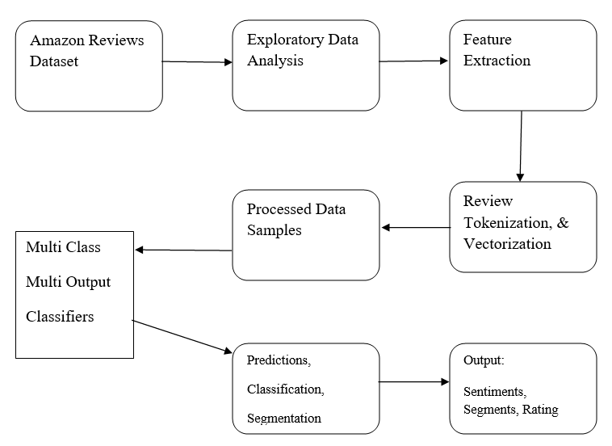
Proposed System

Slide 7
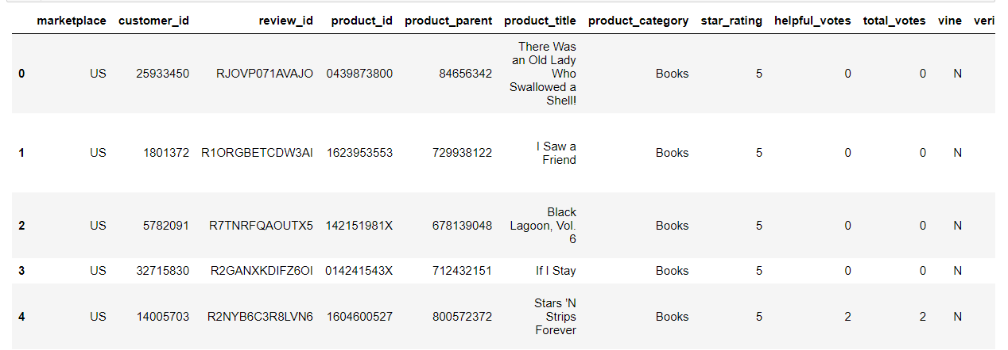
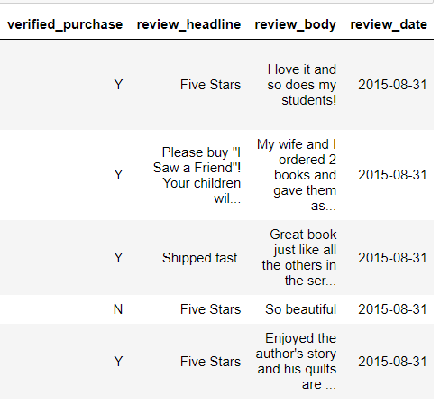
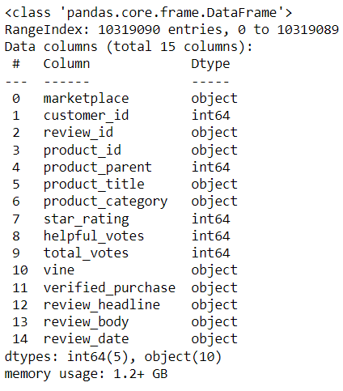
Amazon Dataset

Slide 8
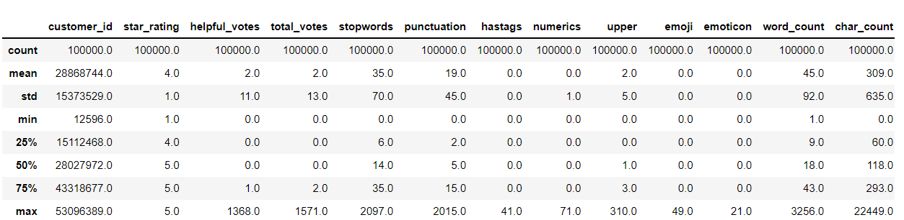
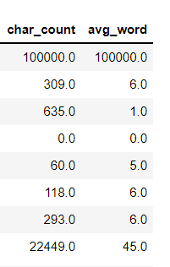
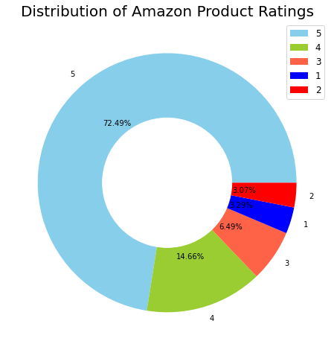
Exploratory Data Analysis

Slide 9
Syntactic Analysis
Analyzes text using basic grammar rules to identify sentence structure.
Tokenization
Part of speech tagging (PoS tagging) Lemmatization & stemming
Stop-word removal
NLP
Techniques
Semantic Analysis
Focuses on capturing the meaning of text.
Word sense disambiguation Relationship extraction

Slide 10
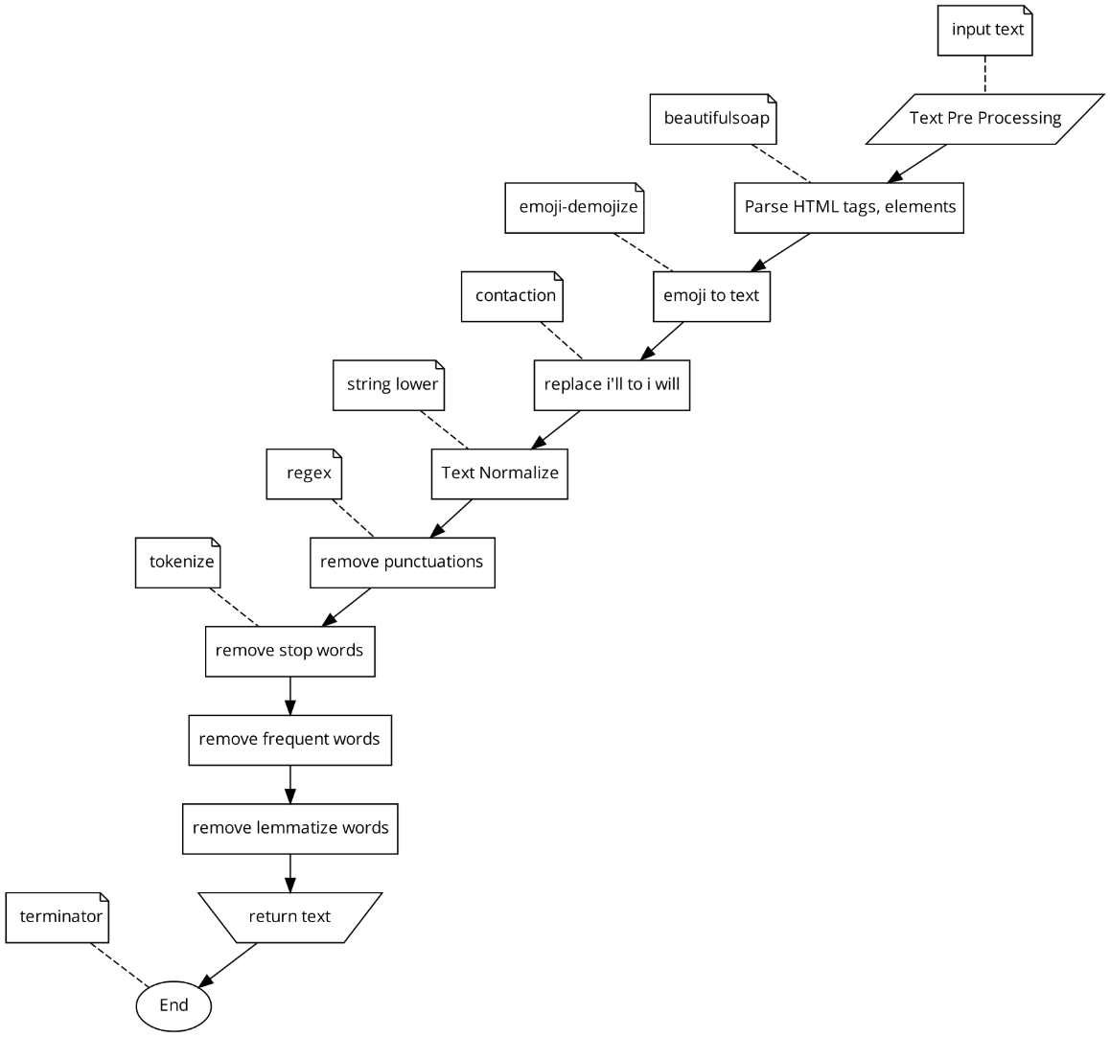
Text
Pre-Processing

Slide 11
Valence aware dictionary for sentiment reasoning (VADER)
Vader Sentiment Analysis

Slide 12
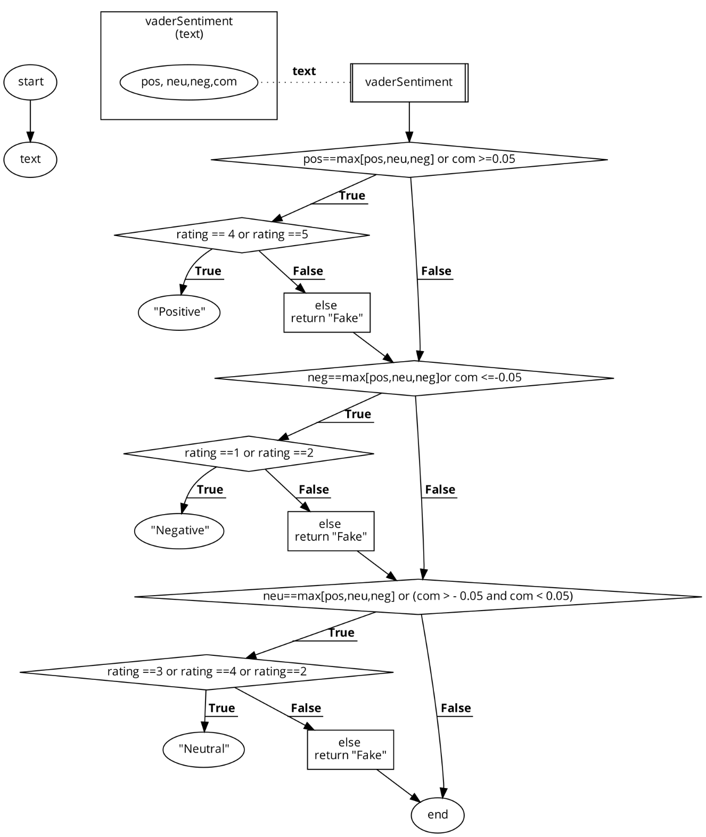
Sentiment Analysis

Slide 13
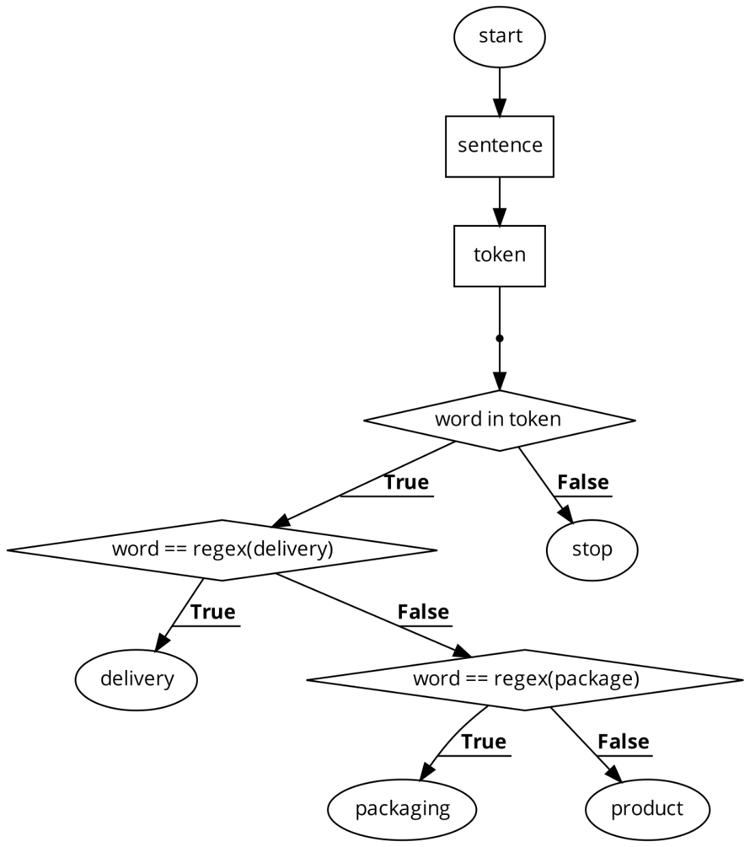
Segmentation

Slide 14
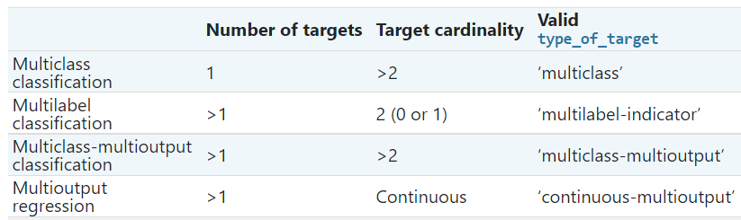
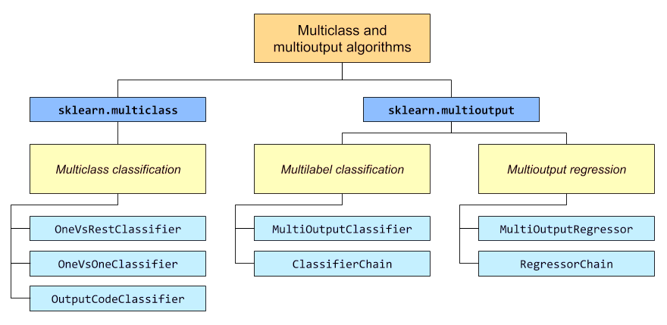
Problem Type and Classification

Slide 15
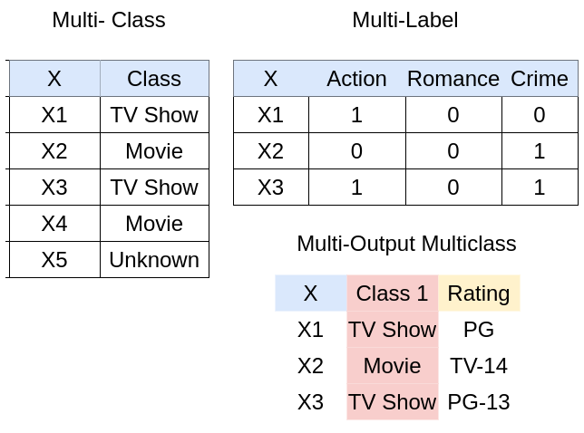
Multi Class Multi Output Classification

Slide 16
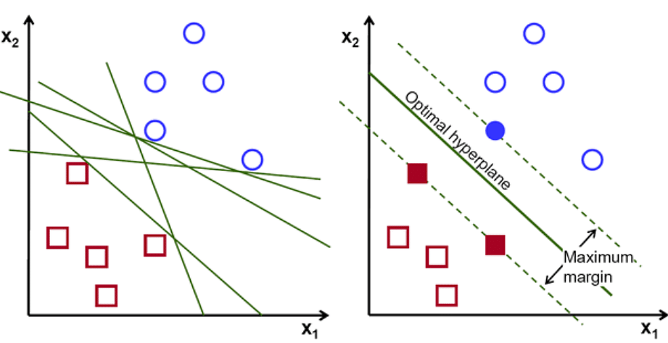
Support Vector Machines (SVM)
SVM algorithm categorizes the classes of a given dataset by determining the best hyperplane or boundary line that divides the given text data into predefined groups.
Consider the above images, where the blue circle represents hate speech, and the red box represents neutral speech.

Slide 17
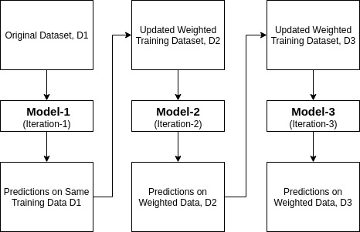
Adaboost Classifier
Ada-boost or Adaptive Boosting is one of the ensemble boosting classifiers proposed by Yoav Freund and Robert Schapire in 1996.
It combines multiple classifiers to increase the accuracy of classifiers. AdaBoost is an iterative ensemble method.

Slide 18

Decision Tree
A Decision Tree is a Supervised learning technique that is a tree-structured classifier, where internal nodes represent the features of a dataset, branches represent the decision rules and each leaf node represents the outcome.

Slide 19
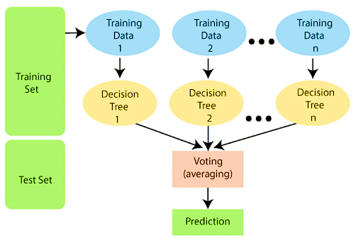
Random Forest Algorithm
Random Forest is a classifier that contains several decision trees on various subsets of the given dataset and takes the average to improve the predictive accuracy of that dataset. It is based on the concept of ensemble learning.

Slide 20
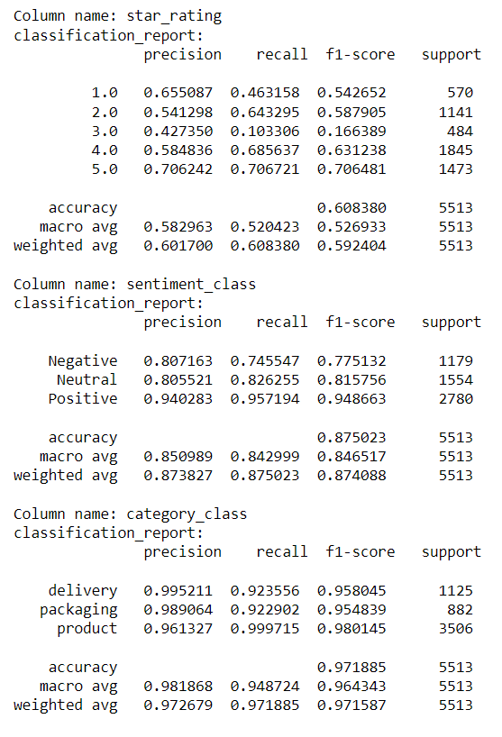
Support Vector Machines (SVM)

Slide 21
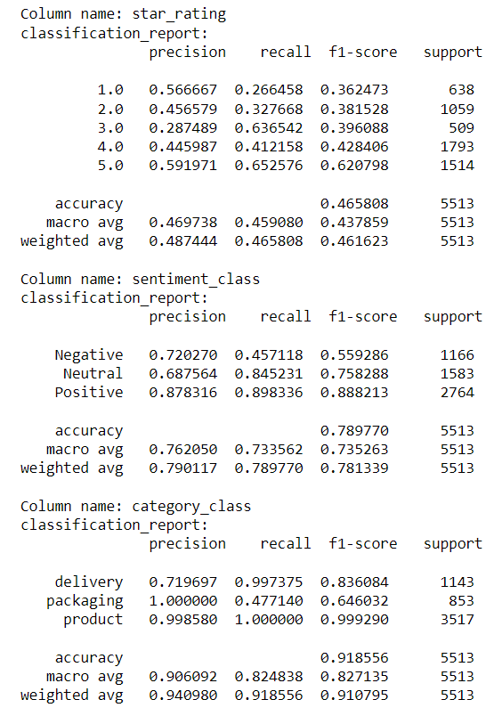
Adaboost Classifier

Slide 22
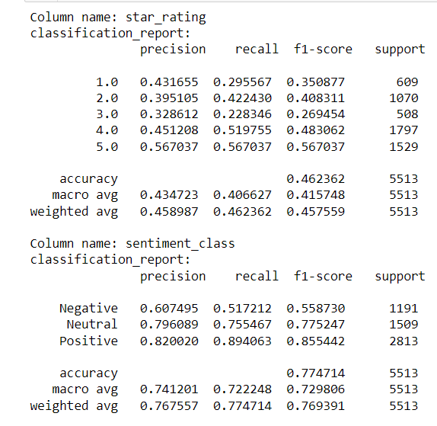
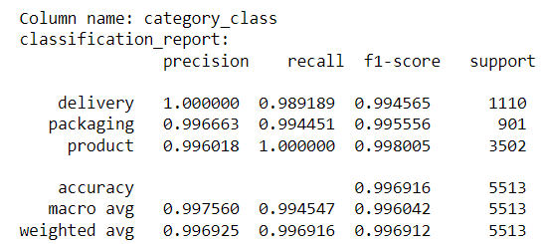
Decision Tree

Slide 23
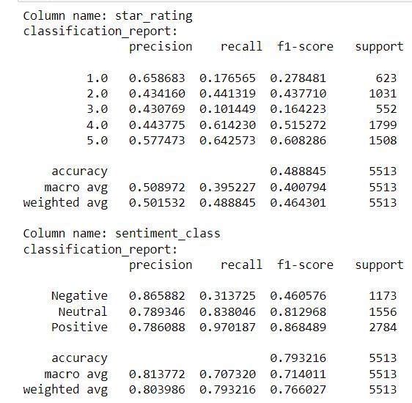
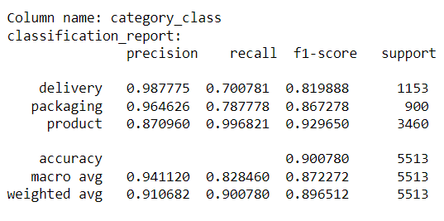
Random Forest Algorithm

Slide 24
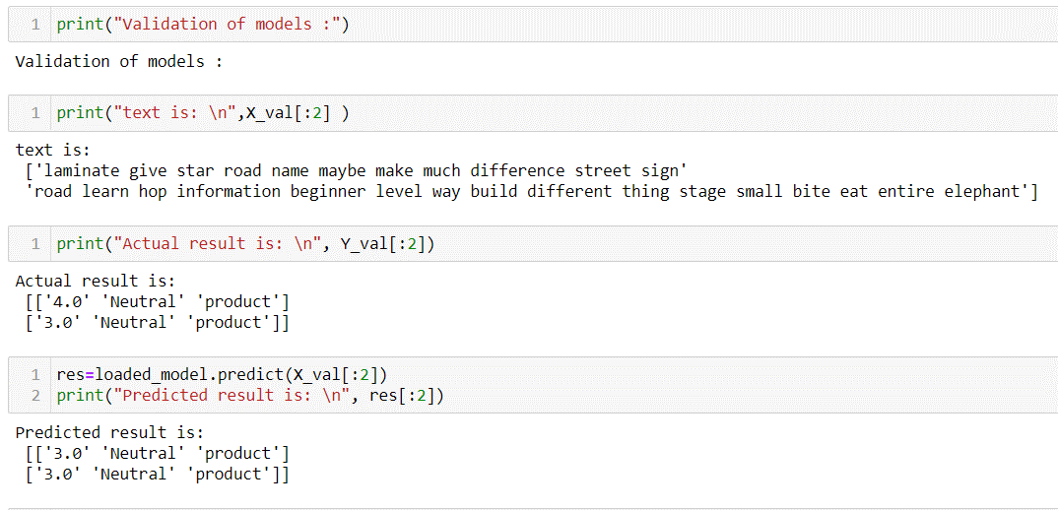
Model Validation Output

Slide 25

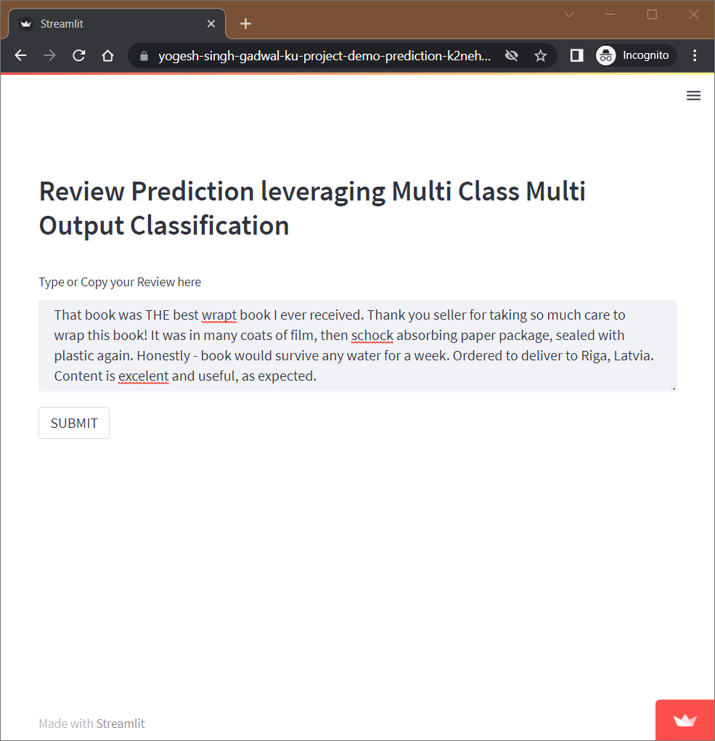
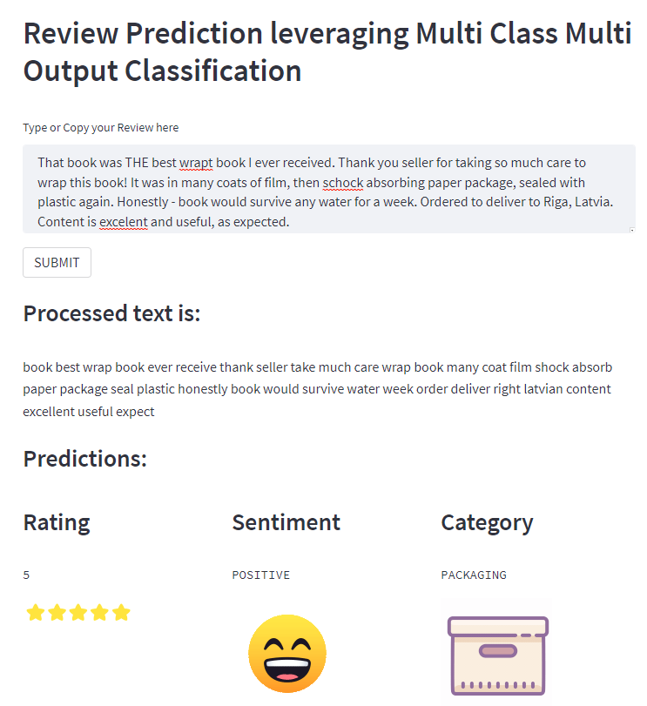
Deployment
https://cutt.ly/JNXAbXB

Slide 26
References
Xu, F.; Pan, Z.; Xia, R. E-commerce product review sentiment classification based on a naïve Bayes continuous learning framework. Inf. Process. Manag. 2020, 57, 102221. [CrossRef]
Vanaja, S.; Belwal, M. Aspect-level sentiment analysis on e-commerce data. In Proceedings of the 2018 International Conference on Inventive Research in Computing Applications (ICIRCA), Coimbatore, India, 11 July 2018; IEEE: Piscataway, NJ, USA, 2018; pp. 1275–1279.
Jabbar, J.; Urooj, I.; JunSheng, W.; Azeem, N. Real-time sentiment analysis on E-commerce application. In Proceedings of the 2019 IEEE 16th International Conference on Networking, Sensing and Control (ICNSC), Banff, AB, Canada, 9–11 May 2019; IEEE: Piscataway, NJ, USA, 2019; pp. 391–396.
Parveen, N.; Santhi, M.; Burra, L.R.; Pellakuri, V.; Pellakuri, H. Women’s e-commerce clothing sentiment analysis by probabilistic model LDA using R-SPARK. Mater. Today Proc. 2021, in press. [CrossRef]
Tripathi, P.; Singh, S.; Chhajer, P.; Trivedi, M.C.; Singh, V.K. Analysis and prediction of extent of helpfulness of reviews on E-commerce websites. Mater. Today Proc. 2020, 33, 4520–4525. [CrossRef]
Kumar, K.S.; Desai, J.; Majumdar, J. Opinion mining and sentiment analysis on online customer review. In Proceedings of the 2016 IEEE International Conference on Computational Intelligence and Computing Research (ICCIC), Chennai, India, 15–17 December 2016; IEEE: Piscataway, NJ, USA, 2016; pp. 1–4.

